Slide 1

PITCH DECK
Bitcoin and cryptocurrencies
Mirjam Nilsson

Slide 2

Python project on Bitcoin and
Cryptocurrencies
About
Made by:
Ananya Agrawal
Guided by:
Kuldeep and Sakib sir

Slide 3


What is Bitcoin
Problem
A peer-to-peer internet currency that allows decentralized transfers of value between individuals and businesses.
COSTS
Businesses need new investment opportunities but are using old or outdated tools and services
Loss of potential income by not offering investment opportunities for businesses
CUSTOMERS
USABILITY
25% increase of investment inquiries prove that there's consumer interest for simpler portfolio management
Customers want something that’s easy to adopt and simple to use
FINANCIALS
Investing in the stock market increased business portfolios by $20 million in 2019

Slide 4
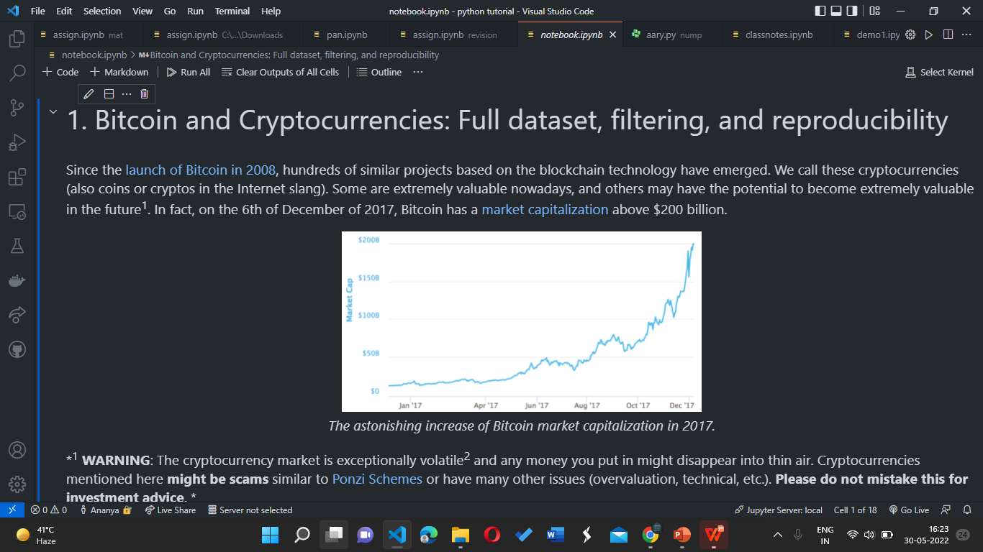

Slide 5

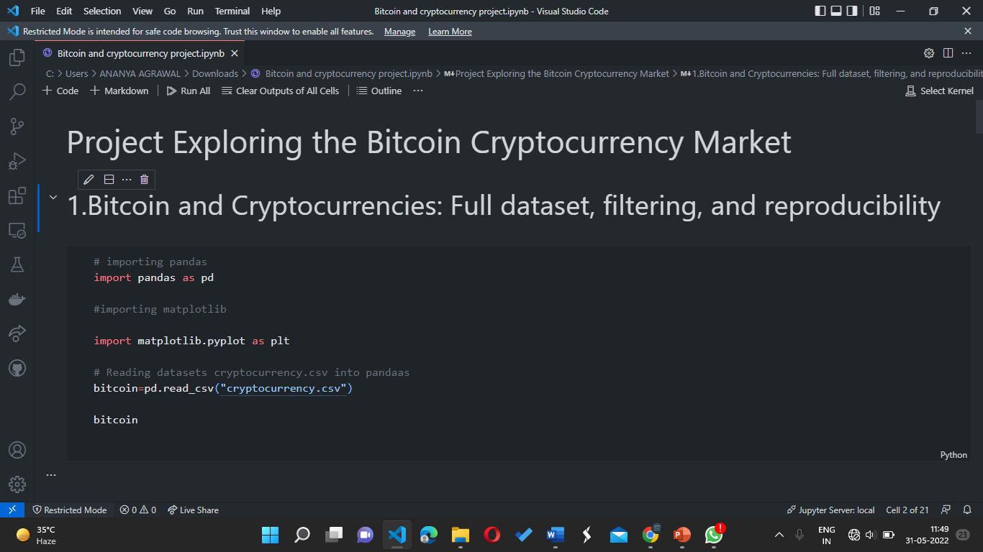
CODE FOR FIRST QUESTION:

Slide 6
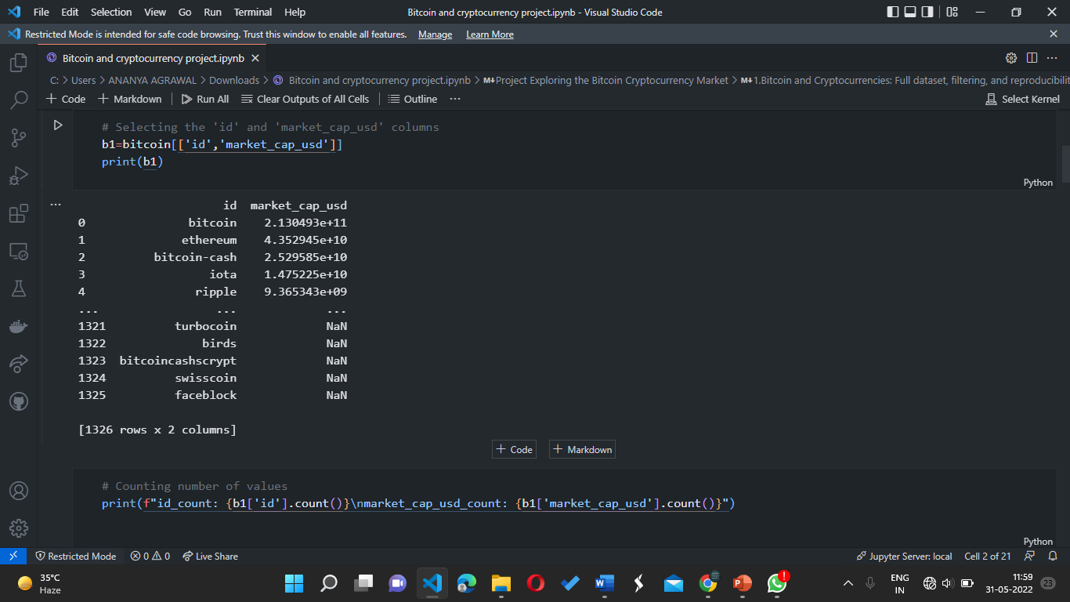
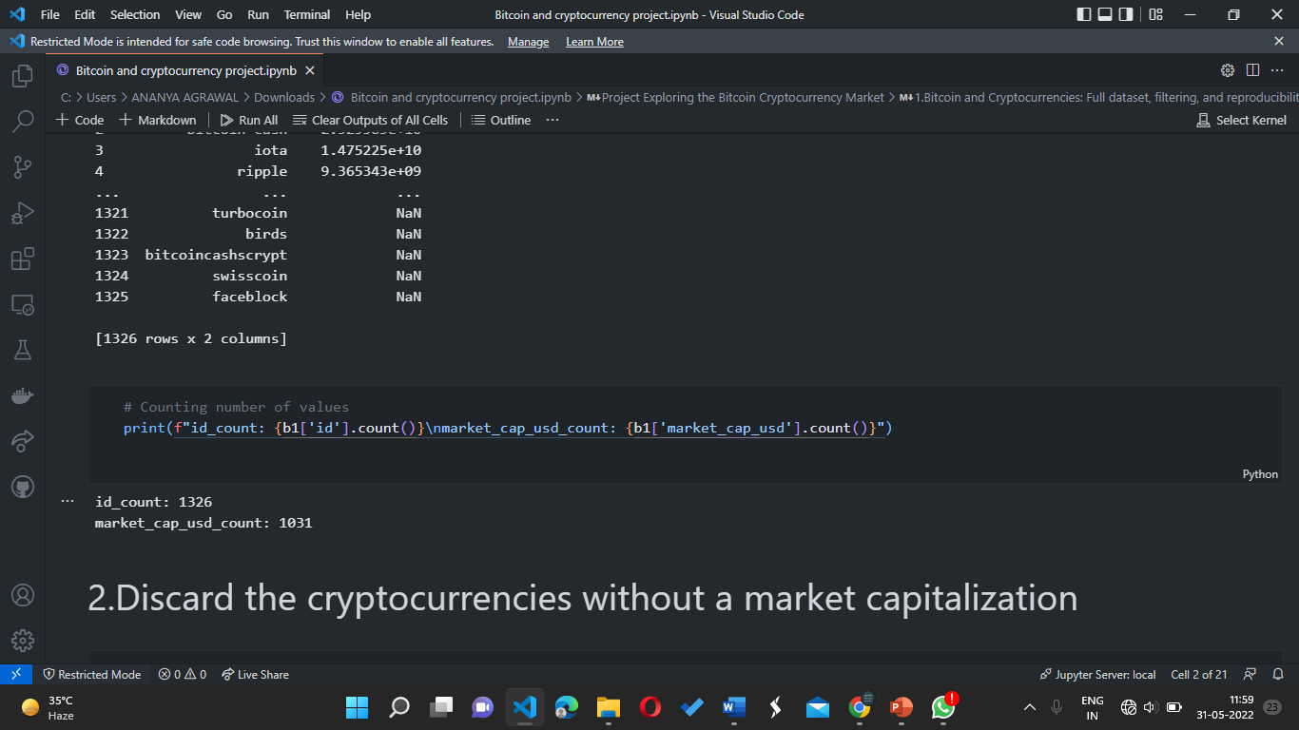

Slide 7
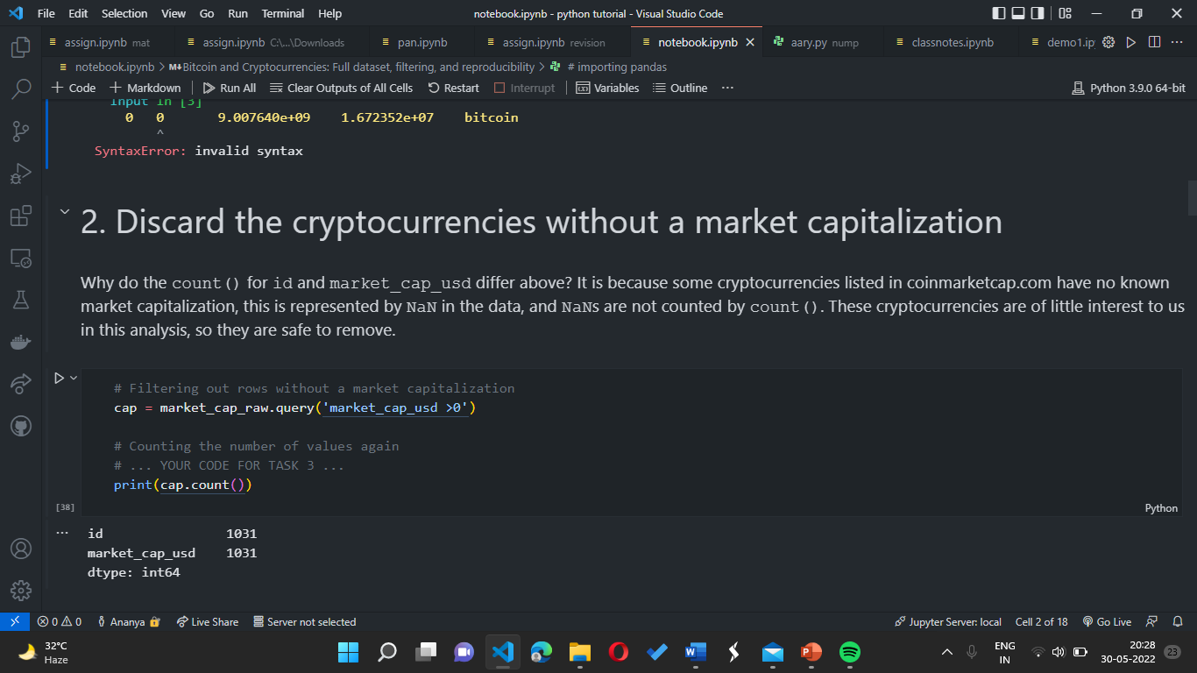
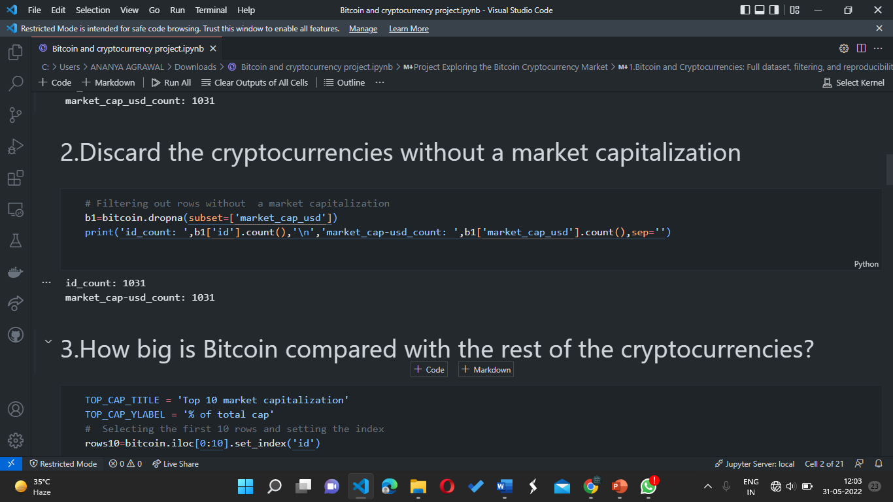
CODE:

Slide 8
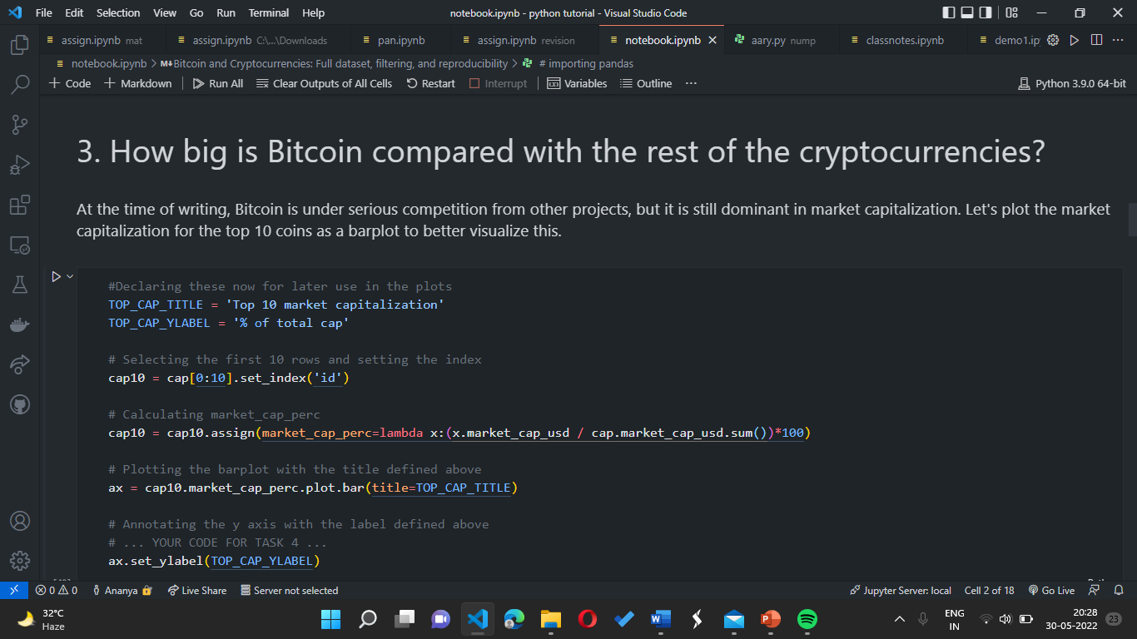
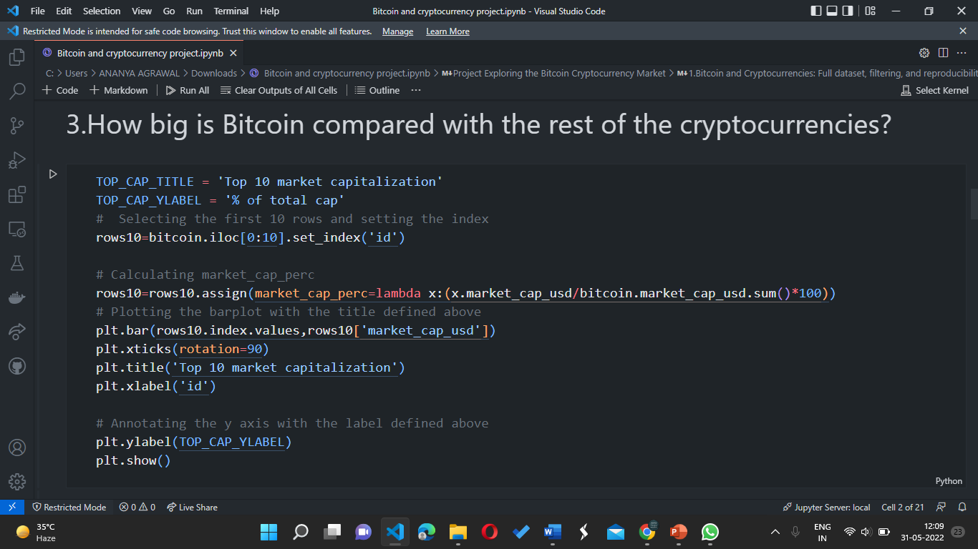
CODE:

Slide 9

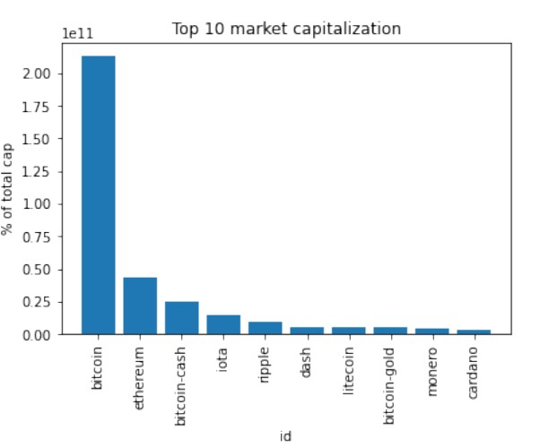
OUTPUT

Slide 10
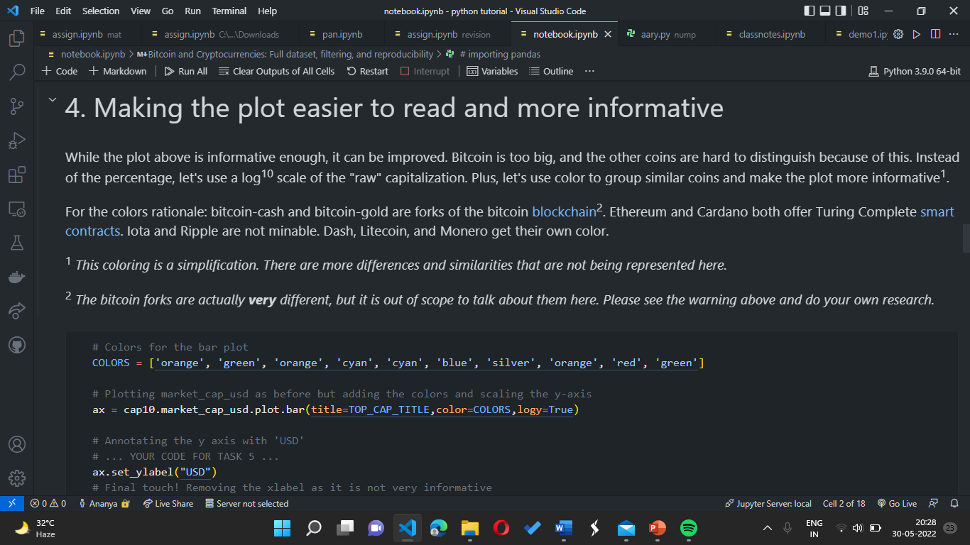

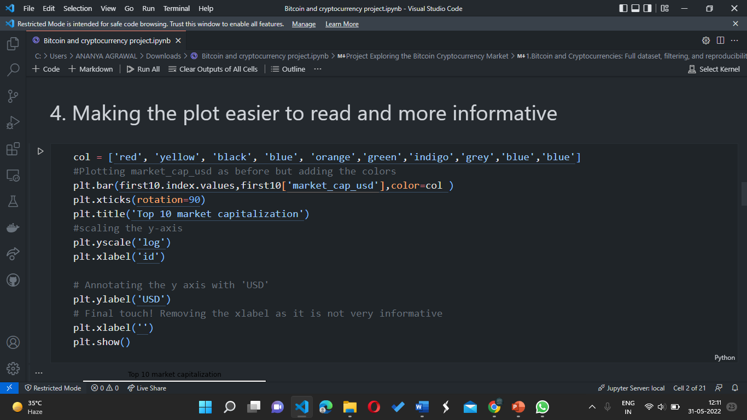
COMPETITORS

Slide 11

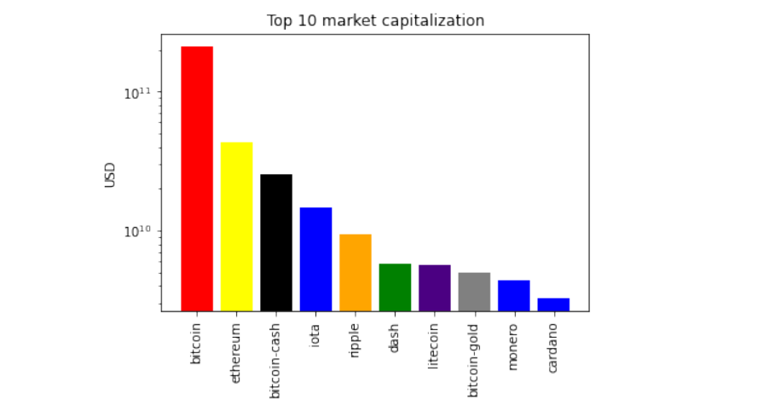
OUTPUT:

Slide 12

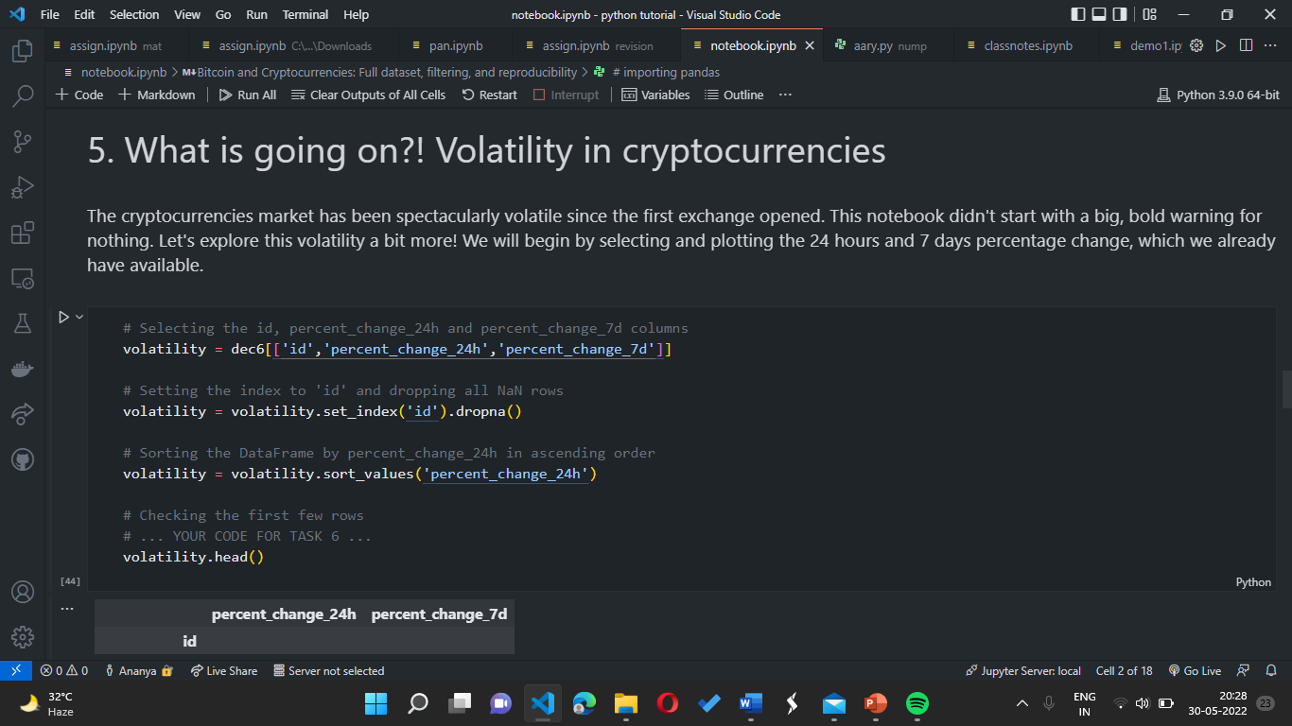
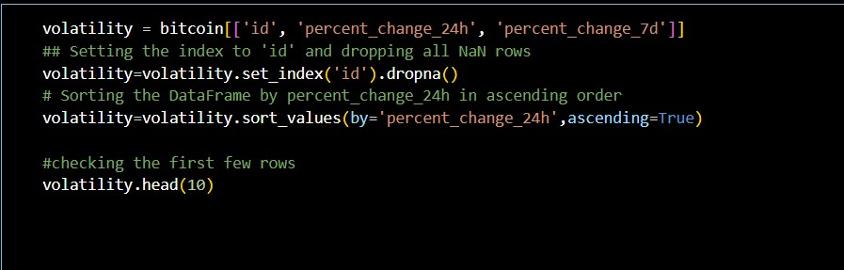
PRODUCT BENEFITS
CODE:
Benefits

Slide 13
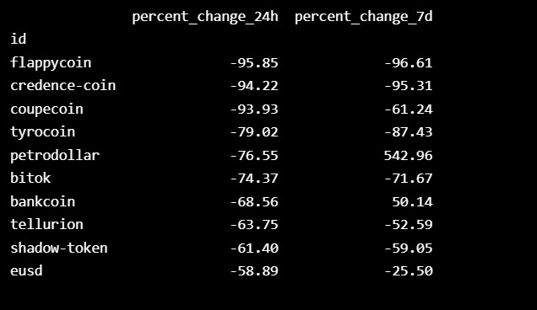
OUTPUT:

Slide 14
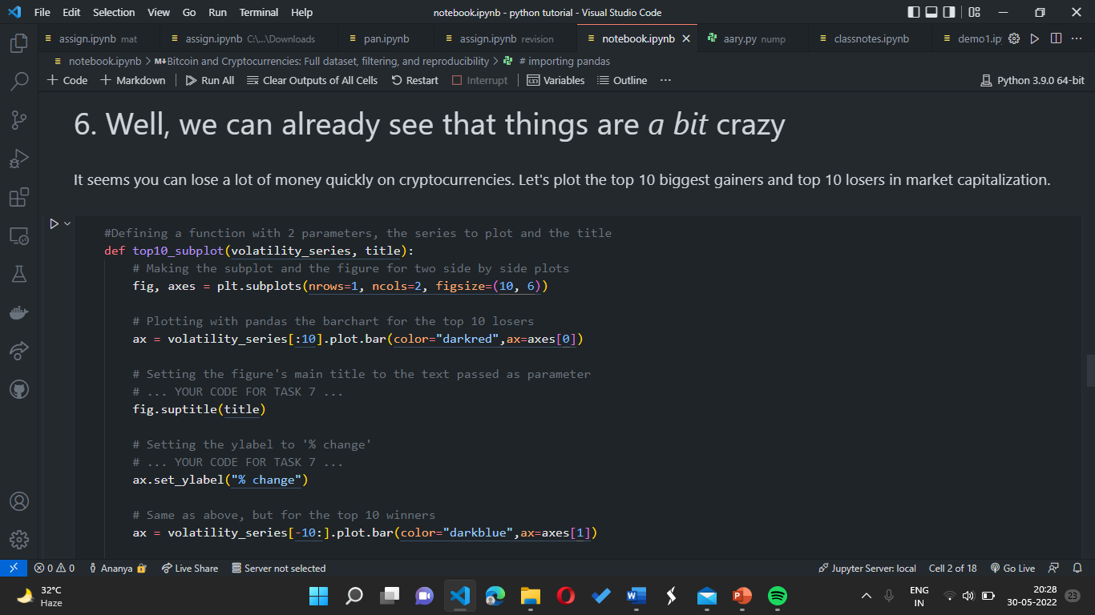

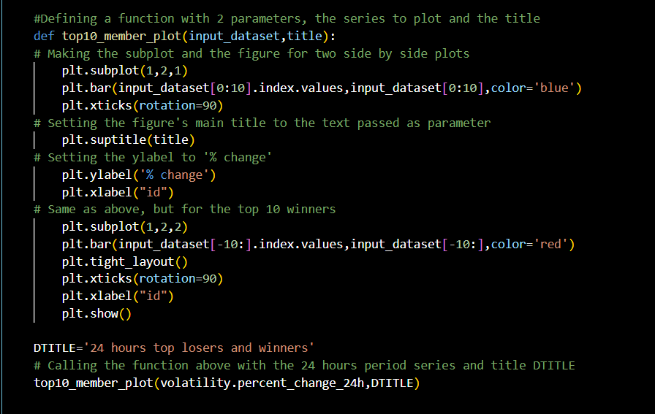
CODE:

Slide 15
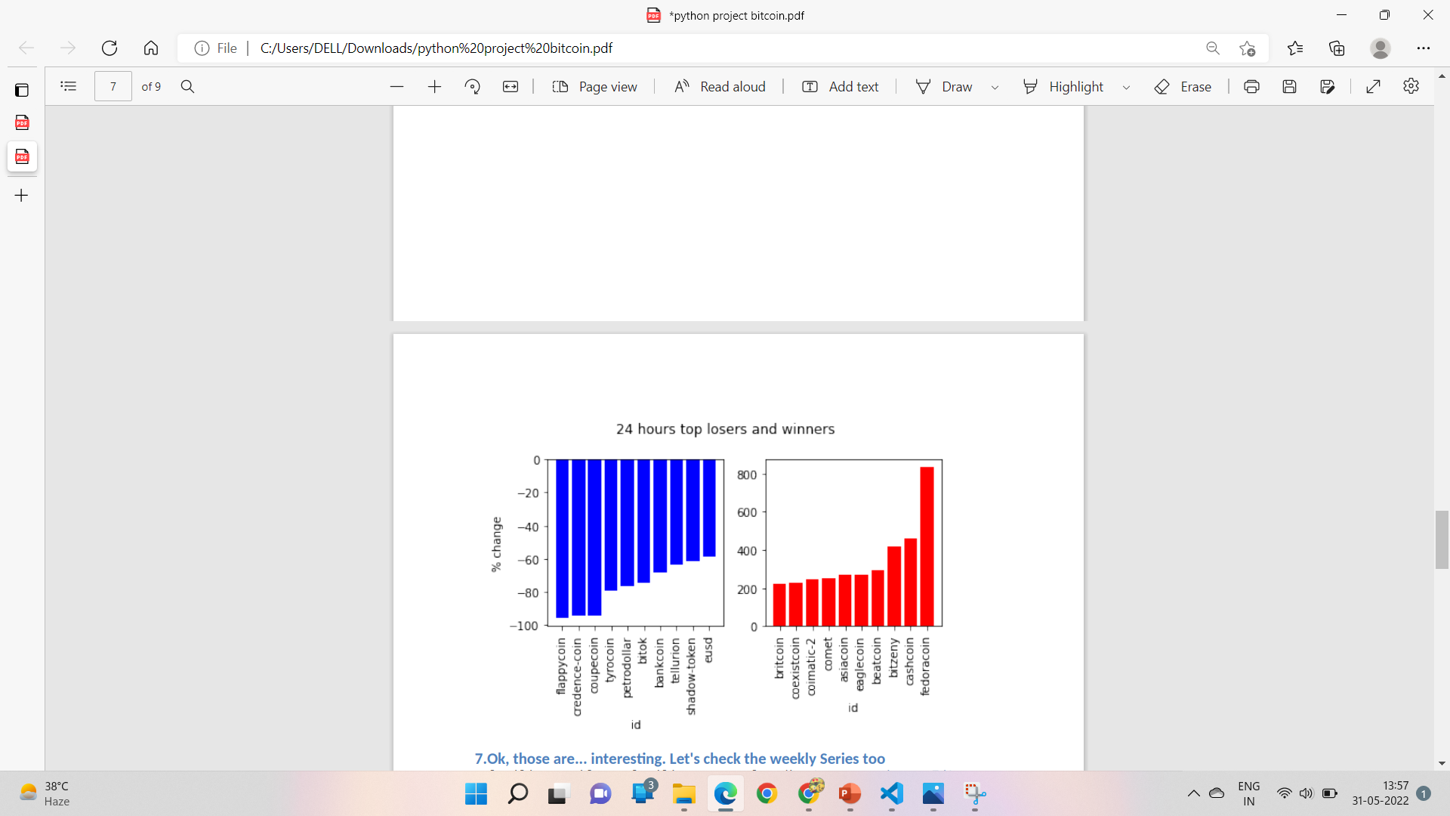
OUTPUT:

Slide 16
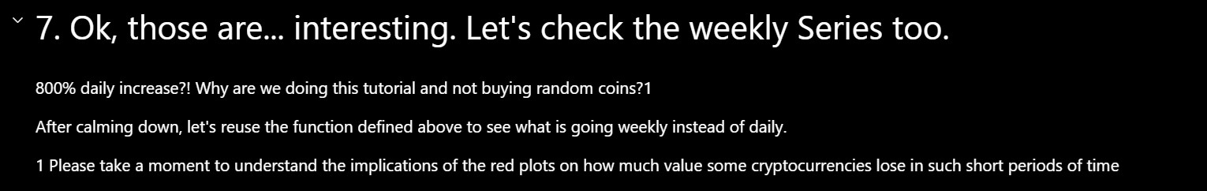
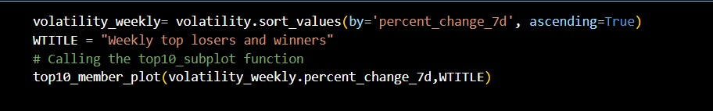
CODE:

Slide 17
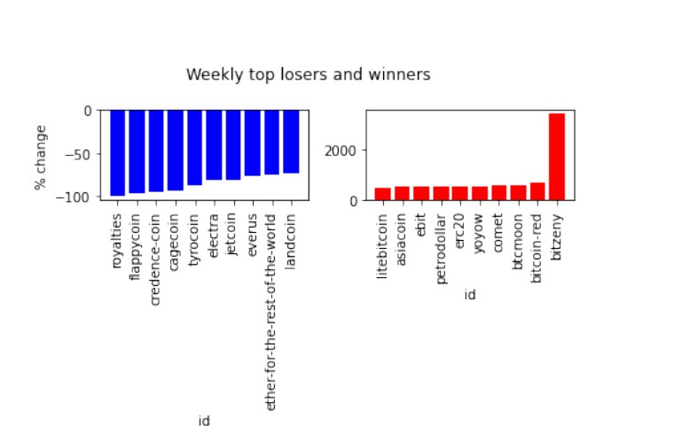
OUTPUT:

Slide 18
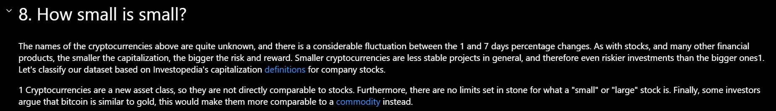
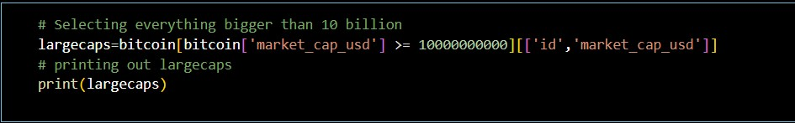
CODE:

Slide 19
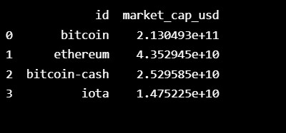
OUTPUT:

Slide 20

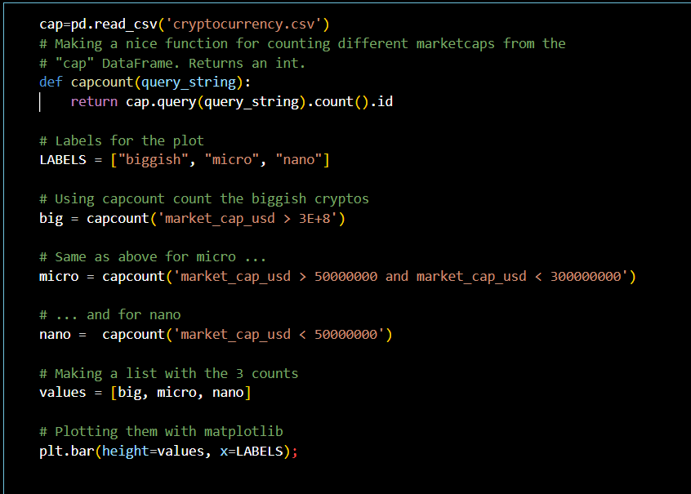
CODE:

Slide 21
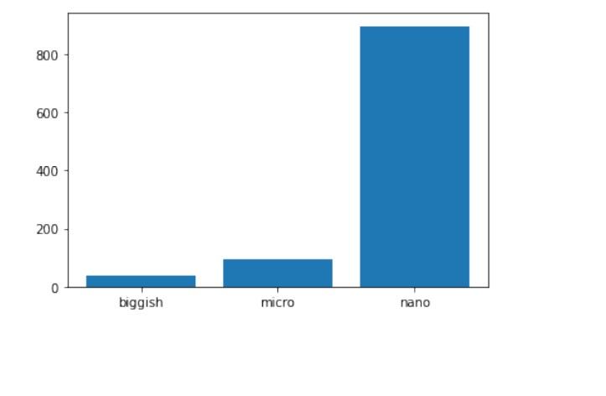
OUTPUT:

Slide 22

BUSINESS MODEL
RESEARCH
ABSTRACT
DESIGN
We based our research on market trends and stock market historical performance data
We believe people need new investment tools to help businesses grow their funds
Minimalist design and easy to use

Slide 23

MARKET OVERVIEW
$3B
$2B
$1B
Opportunity to build
Fully inclusive market
Total addressable market
Freedom to invent
Selectively inclusive market
Serviceable available market
Few competitors
Specifically targeted market
Serviceable obtainable market

Slide 24

MARKET COMPARISON
$3B
$2B
$1B
Opportunity to build
Addressable market
Freedom to invent
Serviceable market
Few competitors
Obtainable market

Slide 25

GROWTH STRATEGY
How we’ll scale in the future
FEB 20XX
MAY 20XX
OCT 20XX
Roll out product to local businesses to help establish the product
Release the product to the general public and monitor stock market trends
Gather feedback from the financial community to expand availability of the product

Slide 26
OUR COMPETITION
Convenient
CONTOSO
A
Expensive
Affordable
D
C
E
B
Inconvenient

Slide 27
TRACTION
Forecasting for success
Key metrics
Revenue by year
 | Clients | Orders | Gross revenue | Net revenue
20XX | 10 | 1100 | $10,000 | $7,000
20XX | 20 | 200 | $20,000 | $16,000
20XX | 30 | 300 | $30,000 | $25,000
20XX | 40 | 400 | $40,000 | $30,000

Slide 28
TWO-YEAR ACTION PLAN
Supply volunteers
Run focus groups
Gather feedback
Feb 20XX
May 20XX
Oct 20XX
20XX
JAN
FEB
MAR
APR
MAY
JUN
JUL
AUG
SEP
OCT
NOV
DEC
20XX
JAN
FEB
MAR
APR
MAY
JUN
JUL
AUG
SEP
OCT
NOV
DEC
Test with businesses
Regional launch
Deliver to consumers
Feb 20XX
July 20XX
Dec 20XX

Slide 29
FINANCIALS
 | Year 1 | Year 2 | Year 3 | Percent of Total
Income
Users | 50,000 | 400,000 | 1,600,000
Sales | 500,000 | 4,000,000 | 16,000,000
Average price per sale | 75 | 80 | 90
Revenue @ 15% | 5,625,000 | 48,000,000 | 216,000,000
Gross profit | 5,625,000 | 48,000,000 | 216,000,000
Expenses
Sales & marketing | 5,062,500 | 38,400,000 | 151,200,000 | 70%
Customer service | 1,687,500 | 9,600,000 | 21,600,000 | 10%
Product development | 562,500 | 2,400,000 | 10,800,000 | 5%
Research | 281,250 | 2,400,000 | 4,320,000 | 2%
Total expenses | 7,593,750 | 52,800,000 | 187,920,000

Slide 30
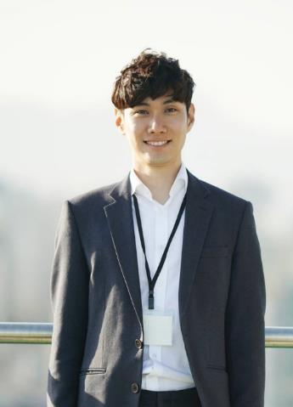
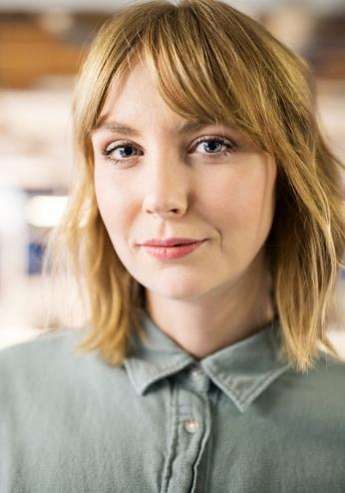

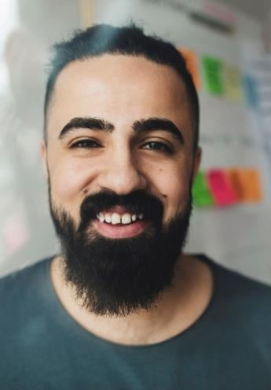
MEET THE TEAM
Takuma Hayashi
Mirjam Nilsson
Flora Berggren
Rajesh Santoshi
President
Chief Executive Officer
Chief Operations Operator
VP Marketing

Slide 31
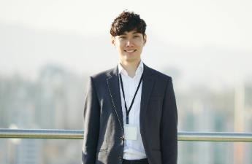







MEET THE FULL TEAM
Takuma Hayashi
Mirjam Nilsson
Flora Berggren
Rajesh Santoshi
President
Chief Executive Officer
Chief Operations Officer
VP Marketing
Graham Barnes
Rowan Murphy
Elizabeth Moore
Robin Kline
VP Product
SEO Strategist
Product Designer
Content Developer

Slide 32
FUNDING
MUTUAL FUNDS
ANGEL INVESTMENTS
CASH
SHARES
$12,000
$14,000
$32,000
$82,000
Revenue obtained from blue chip mutual funds
Amount obtained through other investors
Liquid cash we have on hand
Number of shares converted into USD

Slide 33

SUMMARY
At Contoso, we believe in giving 110%. By closing the loop on investment management and using the latest technology, we help businesses grow and expand their portfolio funds. We thrive because of our market knowledge and a great team behind our product. As our CEO says, "Efficiencies will come from proactively transforming how we do business."
summary

Slide 34

Thank You
Mirjam Nilsson
206-555-0146
Mirjam@contoso.com
www.contoso.com

